Slide 1

How to Build Trust on Human Computer Interaction in Modern Platforms?
Aritra Dhar
ETH Zurich

Slide 2
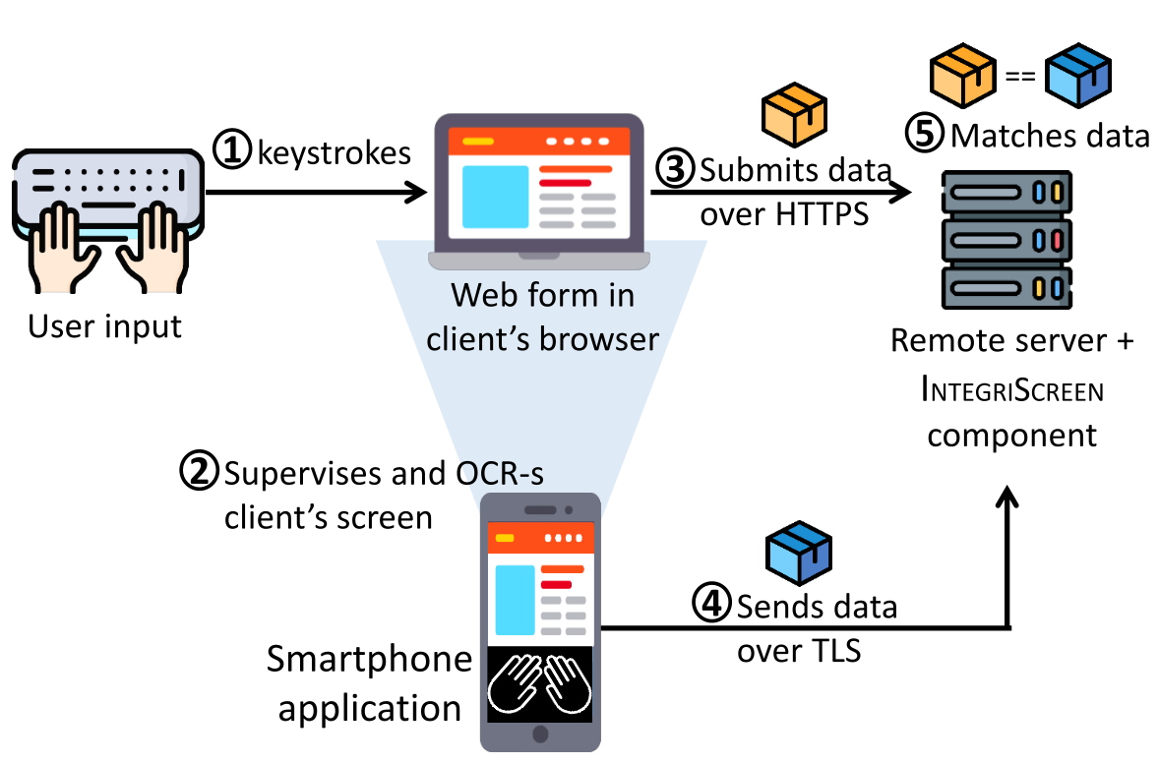
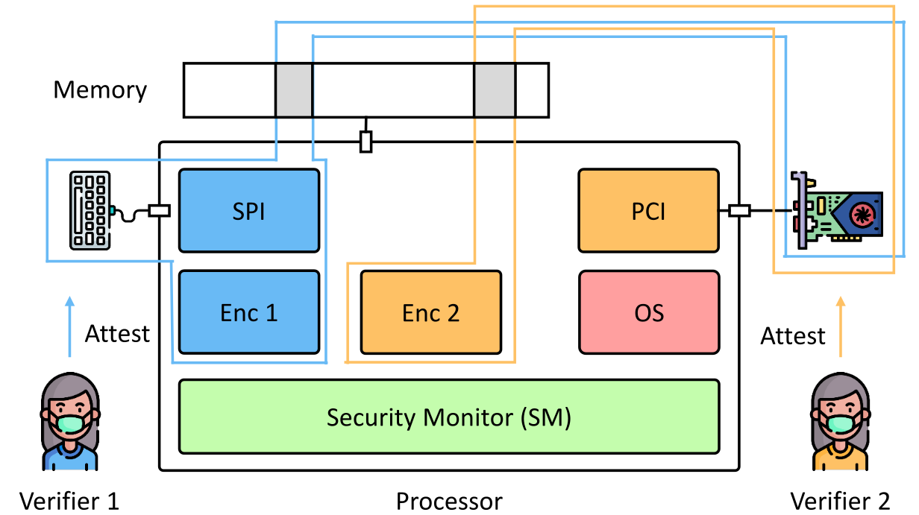
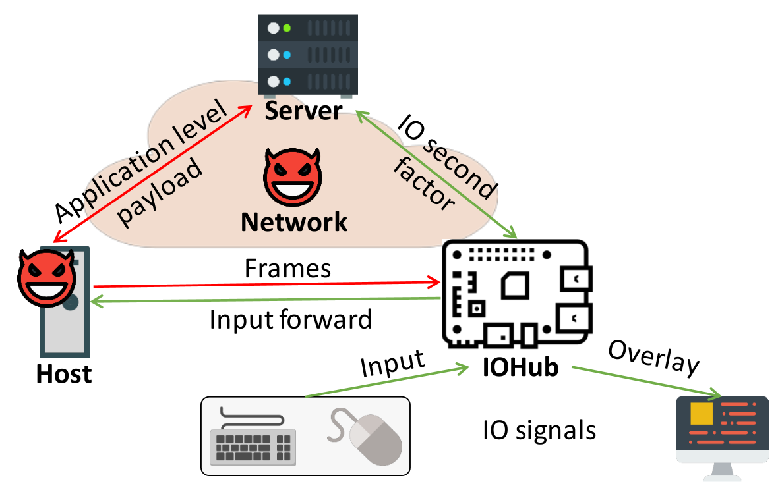
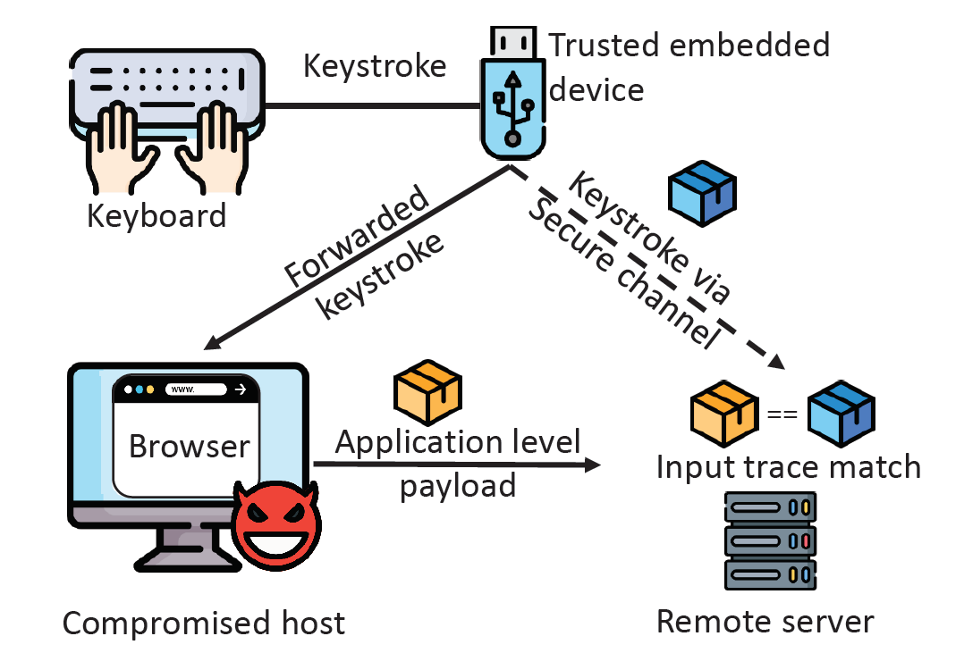
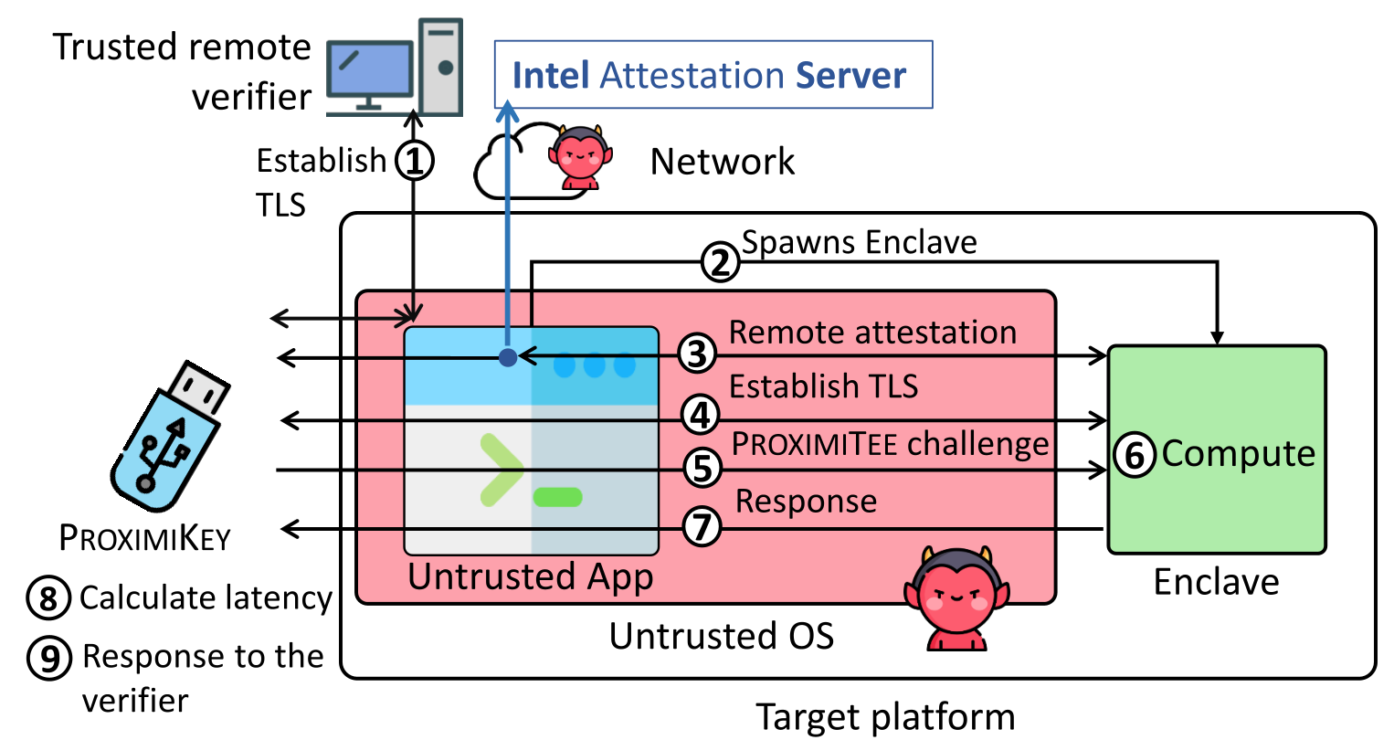
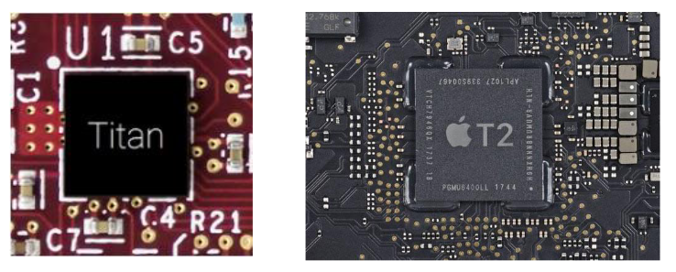
Thesis contribution
Ad-Hoc trusted path solutions
IntegriKey (2017, eprint: 2017/1245)
IntegriScreen (2018, arXiv:2011.13979)
Fundamentals of trusted path
ProtectIOn (NDSS 2020)
Assertion on identity of a platform
ProximiTEE (CODASPY 2020)
External security chips for TEEs
Hardware assisted security (IEEE Security & Privacy 2020)
Reconfigurable HW/SW TCB
PIE (2020, arXiv:2010.10416)

Slide 3
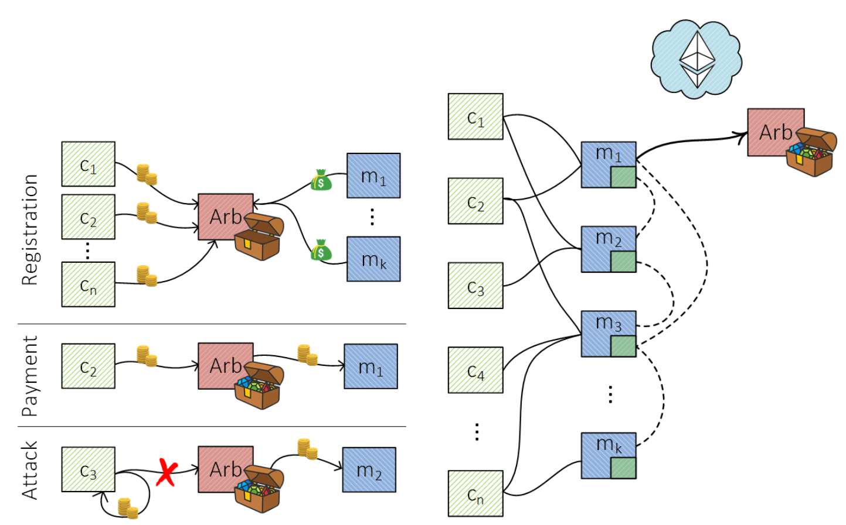
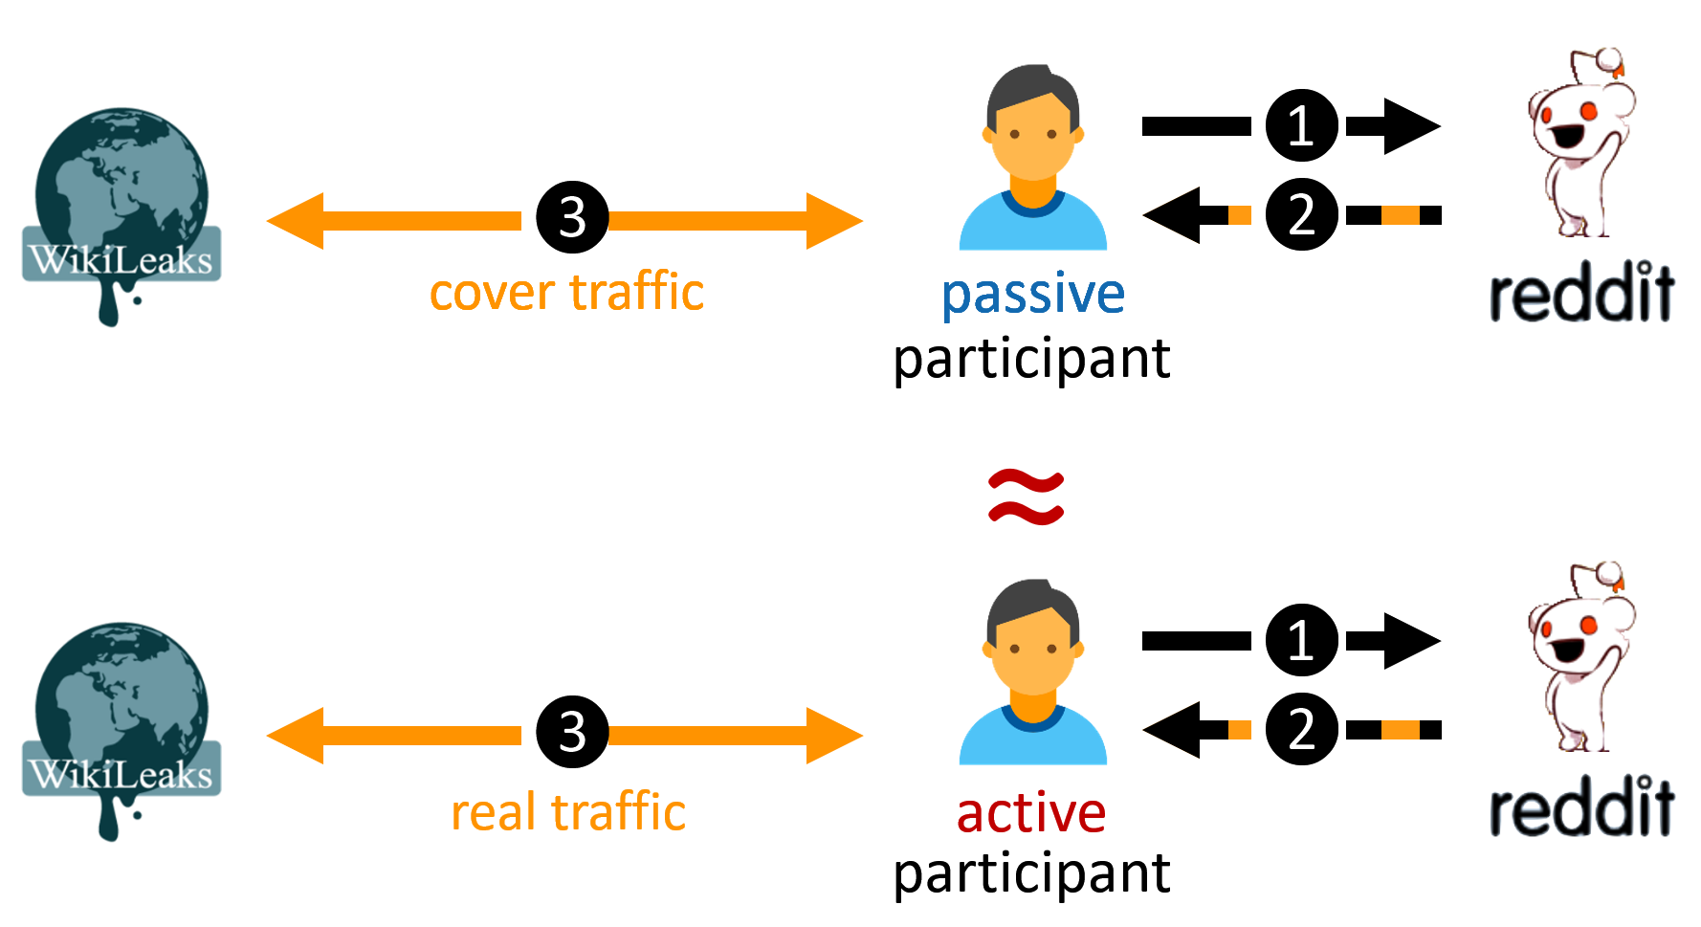
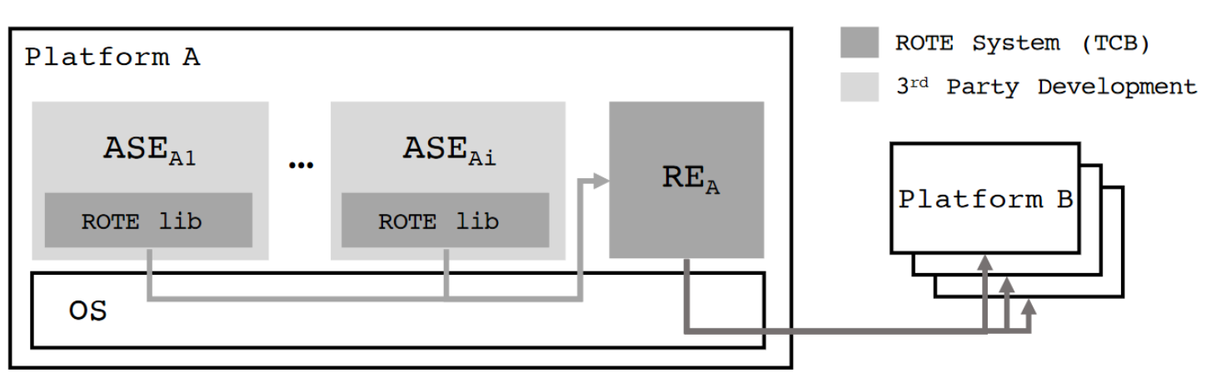
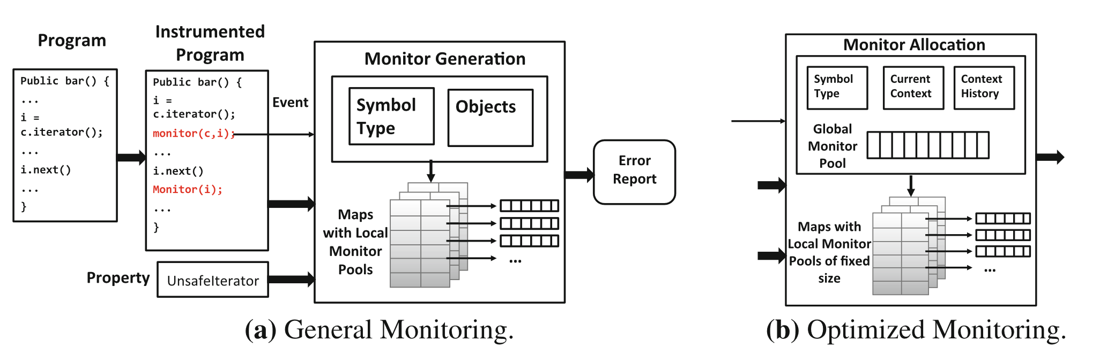
Other contributions
Fast off-chain payments
Snappy (NDSS 2020)
Anonymous communication
CoverUp (NSDI 2019)
Finite state monitoring
Metis (RV 2018)
Rollback protection for SGX
ROTE (USENIX 2017)

Slide 4
Today’s talk
Ad-Hoc trusted path solutions
IntegriKey (2017, eprint: 2017/1245)
IntegriScreen (2018, arXiv:2011.13979)
Fundamentals of trusted path
ProtectIOn (NDSS 2020)
Assertion on identity of a platform
ProximiTEE (CODASPY 2020)
External security chips for TEEs
Hardware assisted security (IEEE Security & Privacy 2020)
Reconfigurable HW/SW TCB
PIE (2020, arXiv:2010.10416)

Slide 5
Today’s talk
Ad-Hoc trusted path solutions
IntegriKey (2017, eprint: 2017/1245)
IntegriScreen (2018, arXiv:2011.13979)
Fundamentals of trusted path
ProtectIOn (NDSS 2020)
Assertion on identity of a platform
ProximiTEE (CODASPY 2020)
External security chips for TEEs
Hardware assisted security (IEEE Security & Privacy 2020)
Reconfigurable HW/SW TCB
PIE (2020, arXiv:2010.10416)

Slide 6



Motivation
Remote device
Heart beat
75
Insulin (U)
177
Basal rate (U/Hr)
0.025
Low limit (mg/dL)
60
High limit (mg/dL)
105
Program
Cancel

Slide 7

Motivation
Remote device
Heart beat
75
Insulin (U)
177
Basal rate (U/Hr)
0.025
Low limit (mg/dL)
60
High limit (mg/dL)
105
Program
Cancel

Slide 8







Remote Trusted path
User
IO devices
Host
Remote server

Slide 9







Solution 1: Transaction Confirmation Device
Remote device
Heart beat
75
Insulin (U)
177
Basal rate (U/Hr)
0.025
Low limit (mg/dL)
60
Android Protected Confirmation
You are going to program
Heart beat 75
Insulin 177U
Basal rate 0.025 U/Hr
Low level 60 mg/dL
High level 105 mg/dL
And more ……
High limit (mg/dL)
105
Program
Cancel

Slide 10



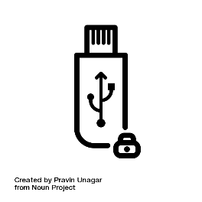
Solution 2: Input Signing
Remote device
Heart beat
75
Insulin (U)
177
Heart beat 75
Insulin 177U
Basal rate 0.025 U/Hr
Low level 60 mg/dL
High level 105 mg/dL
Basal rate (U/Hr)
0.025
Low limit (mg/dL)
60
Trusted embedded device
High limit (mg/dL)
105
Program
Cancel

Slide 11



Display manipulation attack
177
177
Insulin
17
7
1777
Insulin
177
User sees 177
Device records 1777
Host sends 1777
IntegriKey

Slide 12
Observation 1
The lack of output integrity – the render of user inputs on the screen – compromises input integrity.

Slide 13

Solution 3: Overlay
Remote device
Remote device
Heart beat
Heart beat
75
Insulin (U)
Insulin (U)
177
Basal rate (U/Hr)
Basal rate (U/Hr)
0.025
Low limit (mg/dL)
Low limit (mg/dL)
60
High limit (mg/dL)
High limit (mg/dL)
105
Program
Cancel
Program
Cancel

Slide 14
Overlay: Output Manipulation
Remote device
Remote device
Heart beat
Insulin (U)
Insulin (U)
Heart rate
Basal rate (U/Hr)
Basal rate (U/Hr)
Low limit (mg/dL)
Low limit (mg/cc)
High limit (mg/dL)
High limit (mg/cc)
Program
Cancel
Program
Cancel

Slide 15

Overlay: Output Manipulation
Remote device
Insulin (U)
177
Heart rate
75
Basal rate (U/Hr)
0.025
Low limit (mg/cc)
6000
High limit (mg/cc)
10500
Program
Cancel

Slide 16
Observation 2
If the protected output is provided out-of-context,
users are more likely not to verify it.
Therefore input integrity can be violated.

Slide 17
Overlay: Early Form Submission Attack
Remote device
Heart beat
75
Textbox in focus
Insulin (U)
17
Basal rate (U/Hr)
0.025
Fidelius
Trusted overlay from FPGA
Low limit (mg/dL)
60
High limit (mg/dL)
105
OS triggers click
Program
Cancel

Slide 18
Observation 3
If not all the modalities of inputs are secured simultaneously, none of them can be fully secured.

Slide 19






Requirements
The lack of output integrity – the render of user inputs on the screen – compromises input integrity.
Inter-dependency between Input and output

Slide 20
Requirements
If not all the modalities of inputs are secured simultaneously, none of them can be fully secured.
All modalities of input

Slide 21
Requirements
If the protected output is provided out-of-context, users are more likely not to verify it. Therefore input integrity can be violated.
Low cognitive load

Slide 22
Requirements
Low TCB and easy deploy

Slide 23
Requirements

Slide 24








ProtectIOn
Low TCB + fast deployment
Input modalities
IOHub

Slide 25
IO Integrity – Overlay Generation
Remote device
Insulin (U)
Heart rate
Simultaneous IO
Basal rate (U/Hr)
Low limit (mg/cc)
High limit (mg/cc)
Program
Cancel
<form action=“/some_action”, signature = “0x45AB…”, id = “0x0ab”>

Slide 26
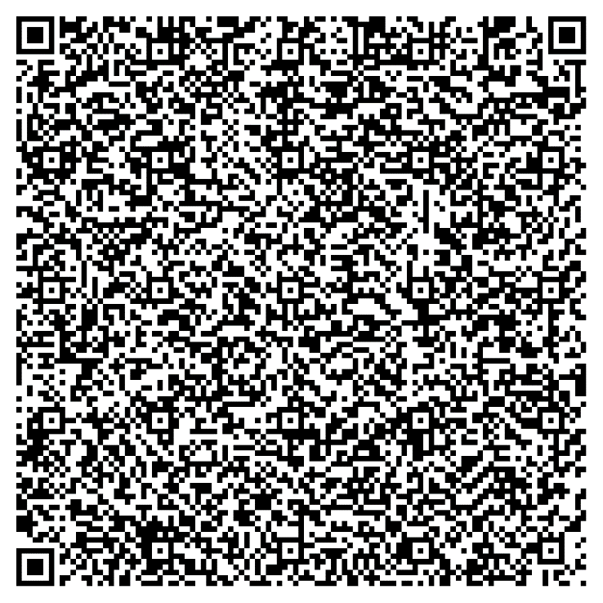

IO Integrity – Overlay Generation
Simultaneous IO

Slide 27


IO Integrity – Overlay Generation
Remote device
Verified UI from secure_site.io
Insulin (U)
Heart rate
Simultaneous IO
Basal rate (U/Hr)
Low limit (mg/cc)
High limit (mg/cc)
Program
Cancel

Slide 28

IO Integrity – Input
Remote device
Verified UI from secure_site.io
Insulin (U)
75
Heart rate
177
Simultaneous IO
Basal rate (U/Hr)
0.025
Low limit (mg/cc)
60
High limit (mg/cc)
105
Program
Cancel

Slide 29
Grabbing User Attention
Output Integrity: Low cognitive load
Several existing mechanisms
Low cognitive load
Put 1 in front of all inputs

Slide 30
Grabbing User Attention
Output Integrity: Low cognitive load
Several existing mechanisms
Lightbox
Low cognitive load
Put 1 in front of all inputs

Slide 31
Grabbing User Attention
Output Integrity: Low cognitive load
Several existing mechanisms
Lightbox
Highlight
Low cognitive load
Put 1 in front of all inputs

Slide 32
Grabbing User Attention
Output Integrity: Low cognitive load
Several existing mechanisms
Lightbox
Highlight
Freezing
Low cognitive load
Put 1 in front of all inputs

Slide 33
Grabbing User Attention
Output Integrity: Low cognitive load
Several existing mechanisms
Lightbox
Highlight
Freezing
Combination
Low cognitive load
Put 1 in front of all inputs

Slide 34
Grabbing User Attention
Output Integrity: Low cognitive load
Several existing mechanisms
Lightbox
Highlight
Freezing
Combination
How to determine when to engage?
Track pointer
Mouse movement on the overlay
Low cognitive load

Slide 35
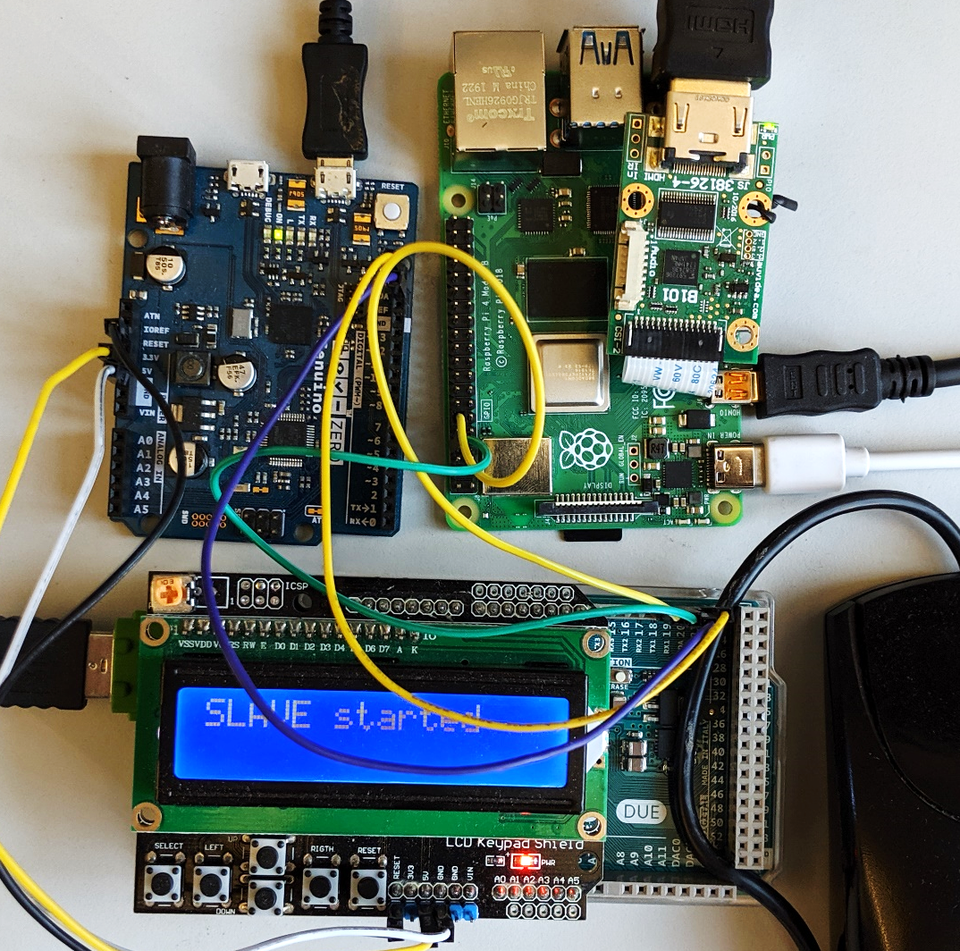









Prototype and TCB
Low TCB
Fast deployment
25.16M
20.92M
1.9K
2M
3.5K
71K
893
600K
121K
36.68M

Slide 36

Performance
Display latency: 21.67 ms
~46 fps
Mouse latency: 250 $μs$
Keyboard latency: 170 $μs$
Pointer detection accuracy: 0.997

Slide 37
Summary
Existing research
Drawbacks
Observations
Requirements for Trusted Path
ProtectIOn design
Prototype

Slide 38


Thank you! Questions?

Slide 39
Backup slides

Slide 40
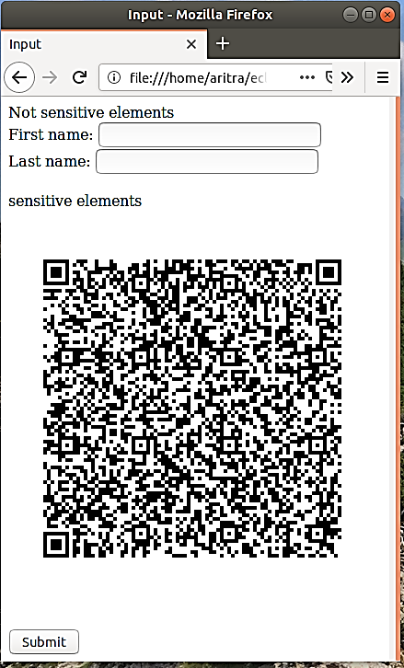
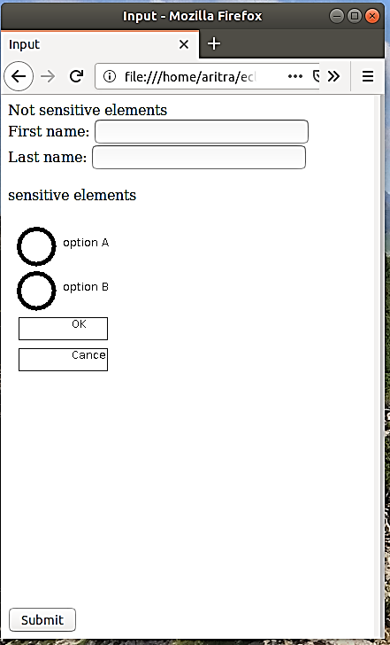
Prototype View
Attacker’s view
User’s view on the monitor
Focusing user’s attention

Slide 41
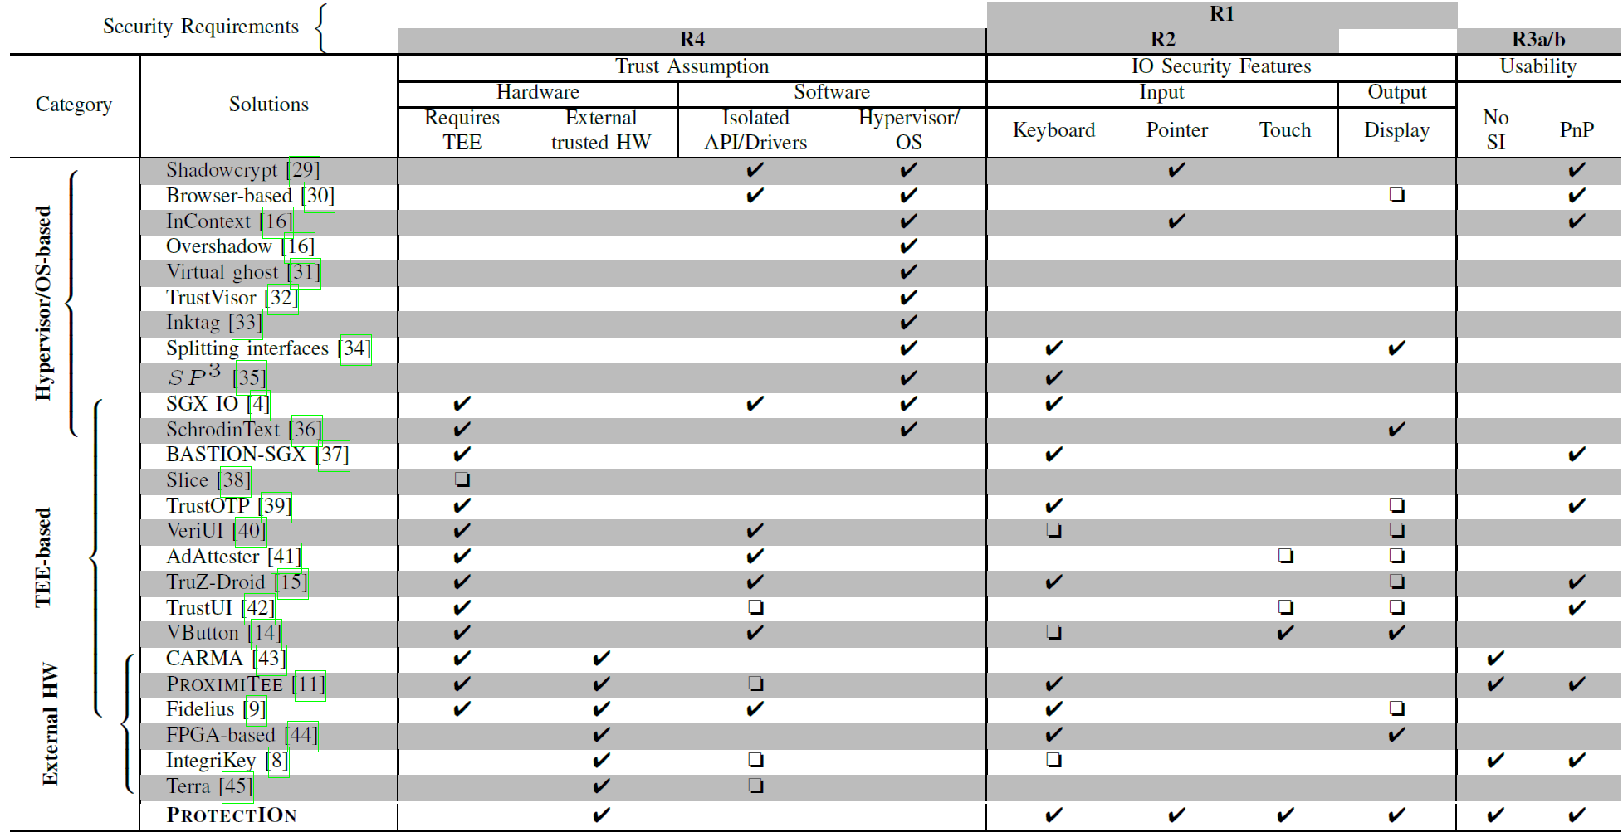
Other Trusted Path Solutions

Slide 42
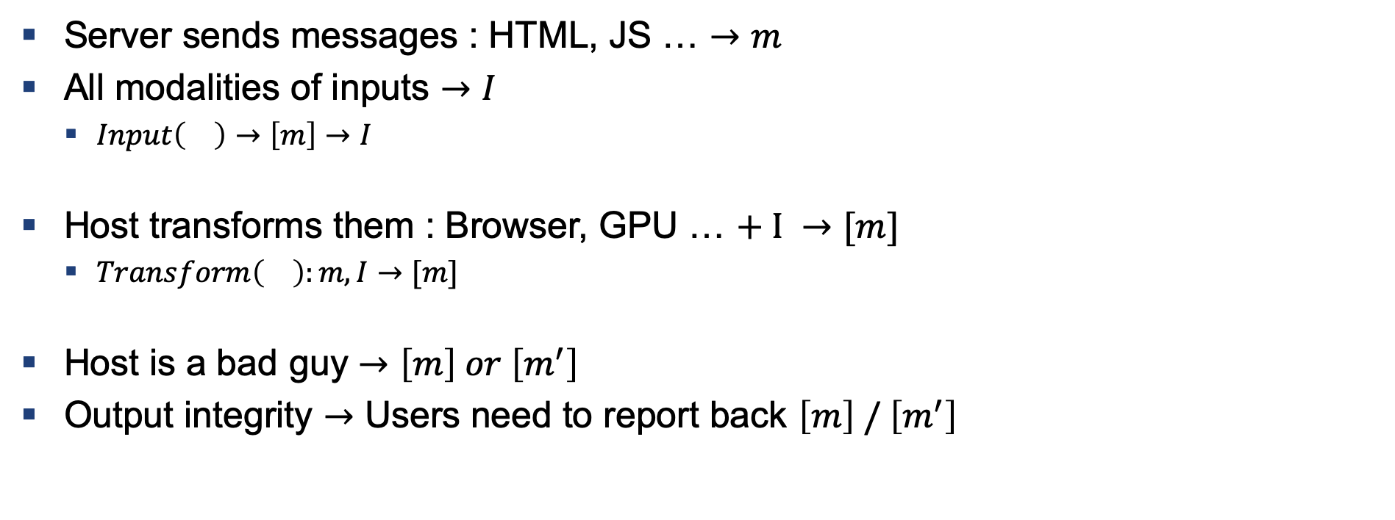
How to Build a Trusted Path
Server sends messages : HTML, JS … $→m$
All modalities of inputs $→I$
$Input\left(\right)→\left[m\right]→I$
Host transforms them : Browser, GPU … $+ I →[m]$
$Transform\left(\right):m,I→[m]$
Host is a bad guy $→\left[m\right] or \left[m^{′}\right]$
Output integrity $→$ Users need to report back $\left[m\right] / \left[m^{′}\right]$

Slide 43
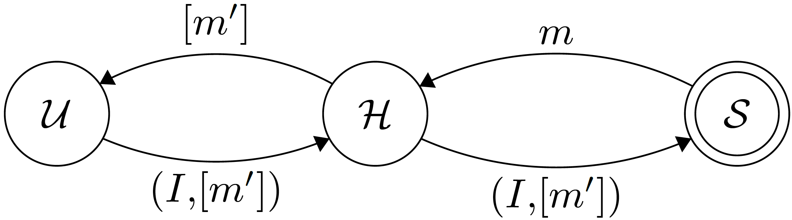
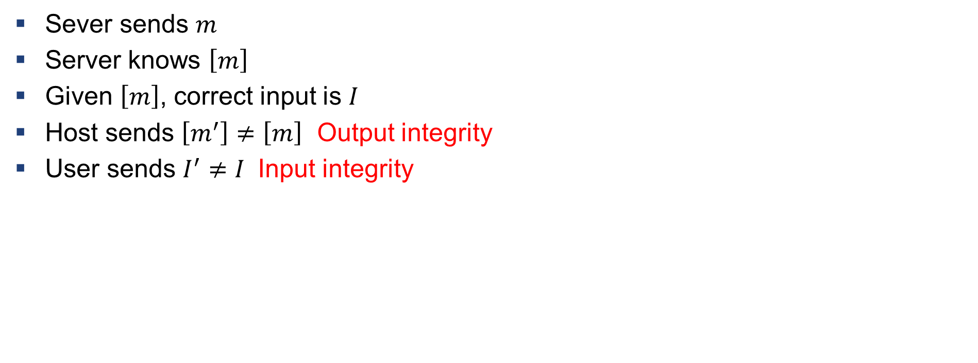
Definition: Violation of Input/output Integrity
Sever sends $m$
Server knows $\left[m\right]$
Given $\left[m\right]$, correct input is $I$
Host sends $\left[m^{′}\right]≠\left[m\right]$ Output integrity
User sends $I^{′}≠I$ Input integrity

Slide 44
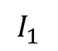
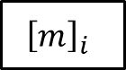
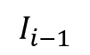
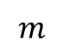
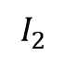
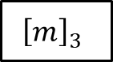
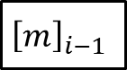
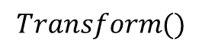
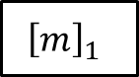
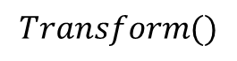
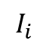
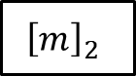

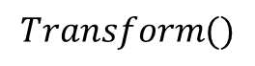
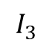
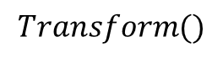
Verification
$$m$$
$$Transform()$$
$${\left[m\right]}_{1}$$
$${\left[m\right]}_{2}$$
$${\left[m\right]}_{3}$$
$${\left[m\right]}_{i−1}$$
$${\left[m\right]}_{i}$$
$$…$$
$$I_{1}$$
$$I_{2}$$
$$I_{3}$$
$$I_{i−1}$$
$$I_{i}$$
$$Transform()$$
$$Transform()$$
$$Transform()$$
Anything missing in the chain $→$ IO integrity violation

